Slide 1

Deep Learning for Natural Language Processing:
Chatbot
June 2019

Slide 2
Dialog Agents
Phone-based Personal Assistants
SIRI, Cortana, Google Now
Talking to your car
Communicating with robots
Clinical uses for mental health
Chatting for fun

Slide 3
Two classes of systems
Goal-based dialog agents
- SIRI, interfaces to cars, robots,
Chatbots

Slide 4
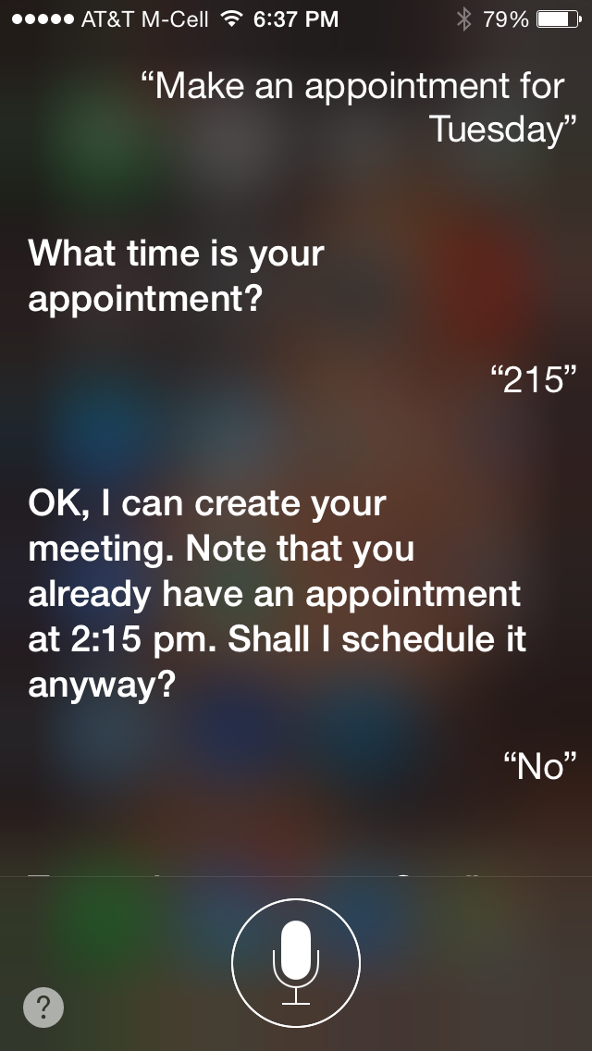
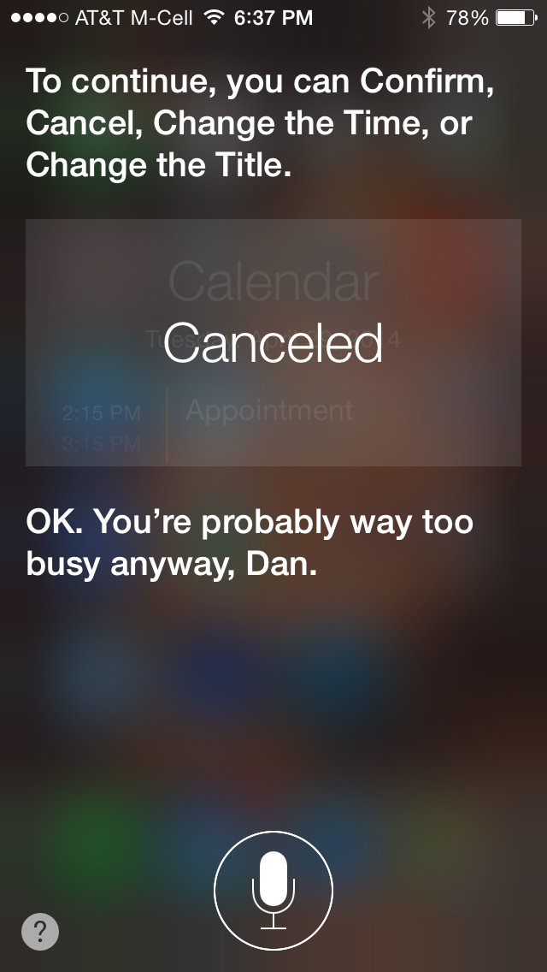
a

Slide 5
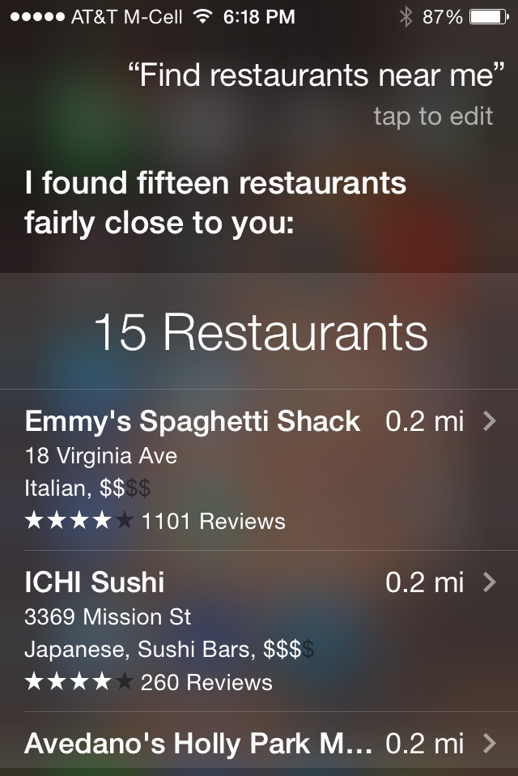
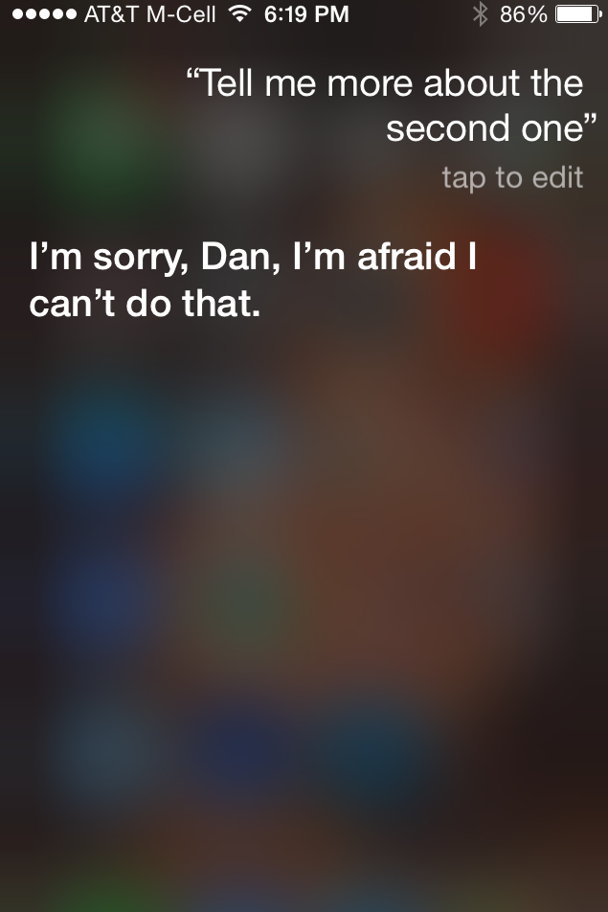

Slide 6
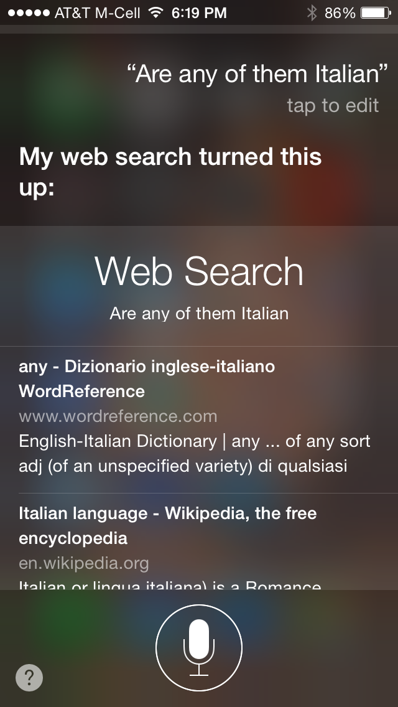

Slide 7
How SIRI works
Figure from Jerome Bellegarda

Slide 8
Architectures for Practical Dialog Systems
Finite-State
Just for passwords or credit cards
Active Ontology/Frame Based
SIRI etc

Slide 9
Finite-State Dialog Management
Consider a trivial airline travel system:
Ask the user for a departure city
Ask for a destination city
Ask for a time
Ask whether the trip is round-trip or not

Slide 10
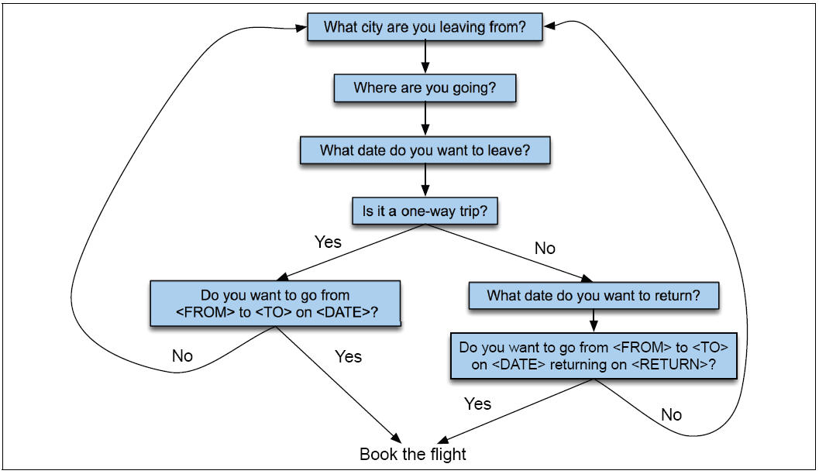
Finite State Dialog Manager

Slide 11
Finite-state dialog managers
System completely controls the conversation with the user.
It asks the user a series of questions
Ignoring (or misinterpreting) anything the user says that is not a direct answer to the system’s questions

Slide 12
Dialogue Initiative
Systems that control conversation like this are system initiative or single initiative.
Initiative: who has control of conversation
In normal human-human dialogue, initiative shifts back and forth between participants.

Slide 13
System Initiative
System completely controls the conversation
Simple to build
User always knows what they can say next
System always knows what user can say next
Known words: Better performance from ASR
Known topic: Better performance from NLU
OK for VERY simple tasks (entering a credit card, or login name and password)
Too limited
+
-

Slide 14
Problems with System Initiative
Real dialogue involves give and take!
In travel planning, users might want to say something that is not the direct answer to the question.
For example answering more than one question in a sentence:
Hi, I’d like to fly from Seattle Tuesday morning;
I want a flight from Milwaukee to Orlando one way leaving after 5 p.m. on Wednesday.

Slide 15
Mixed Initiative
Conversational initiative can shift between system and user
Simplest kind of mixed initiative: use the structure of the frame to guide dialogue
Slot Question
ORIGIN What city are you leaving from?
DEST Where are you going?
DEPT DATE What day would you like to leave?
DEPT TIME What time would you like to leave?
AIRLINE What is your preferred airline?

Slide 16
Chatbot Architectures

Slide 17
Chatbot Architectures
Rule-based
Pattern-action rules (Eliza)
+ a mental model (Parry)
Corpus-based (from large chat corpus)
Information Retrieval
Deep neural nets

Slide 18
Eliza pattern/transform rules
(0 YOU 0 ME) [pattern]
(WHAT MAKES YOU THINK I 3 YOU) [transform]
You hate me
WHAT MAKES YOU THINK I HATE YOU

Slide 19
Deep-learning chatbots
Data:
movie dialogue databases
twitter conversations
Train a deep neural net to map from one users turn to the other users response

Slide 20
Seq2seq model architecture
Serban, Iulian V., Alessandro Sordoni, Yoshua Bengio, Aaron Courville, and Joelle Pineau. 2015. "Building End-To-End Dialogue Systems Using Generative Hierarchical Neural Network Models.

Slide 21
Sample outputs from a neural net chatbot
Jiwei Li, Michel Galley, Chris Brockett, Jianfeng Gao, and Bill Dolan. 2015.
A Diversity-Promoting Objective Function for Neural Conversation Models.
How are you doing?
I’m good, you?
I am off all week next week
What time you going?
I know you love me and I love you.
I love you too, baby.
Ohh I’ve never seen that! How long does it take you guys to learn the drill?
Like 2 weeks ago!!
?

Slide 22
Sample output from a neural net chatbot
Sordoni A, Galley M, Auli M, Brockett C, Ji Y, Mitchell M, Nie JY, Gao J, Dolan B. A neural network approach to context-sensitive generation of conversational responses. NAACL
trained on 127M Twitter context-message-response triples

